Slide 1
FriendZone
Sprint Review 2
Clementine Eckert
William Kummetz
Mario Mendez
Alex Poon
Kevin Welty

Slide 2
FriendZone MARKET RESEARCH
Would you sign up?
If yes, did you find an activity you would like?

Slide 3
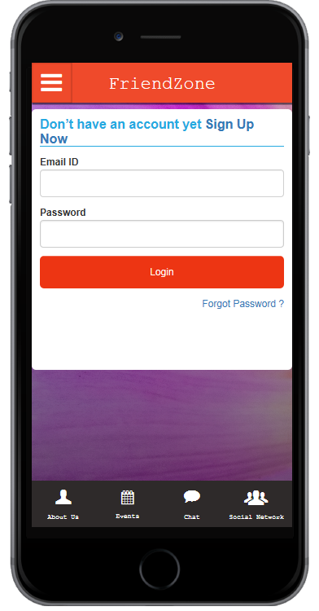
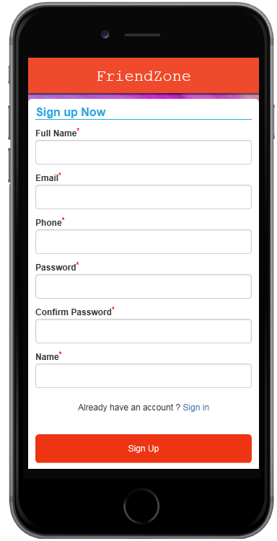
Prototype 1

Slide 4
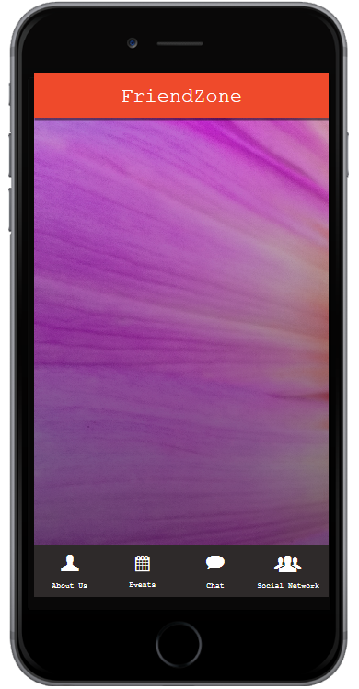

PROTOTYPE 1
Activities
Bowling
Bowling
Sudoku
Create An Event
Join An Event
Coloring
Whittling

Slide 5

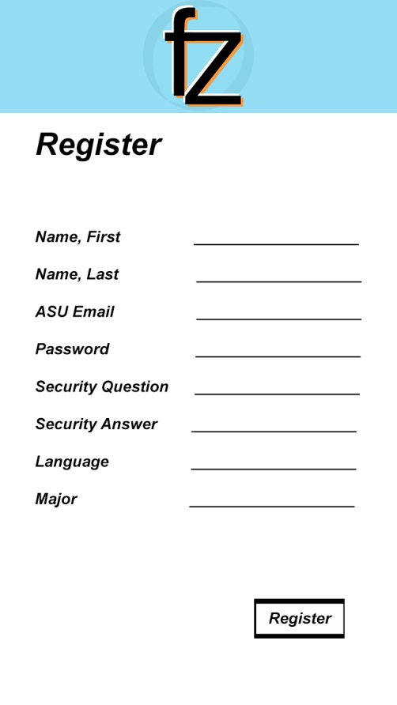
Prototype 2

Slide 6
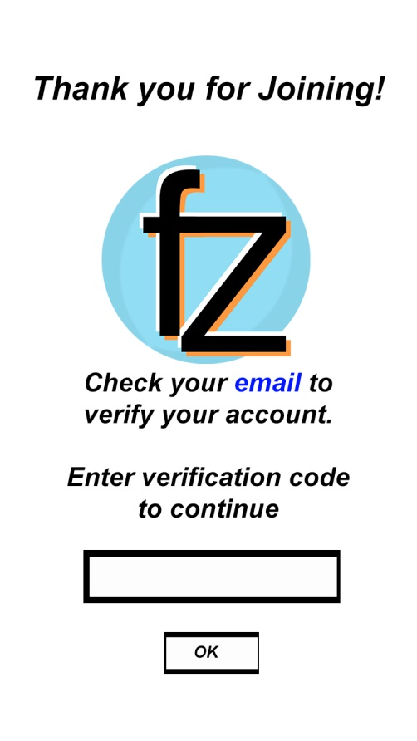
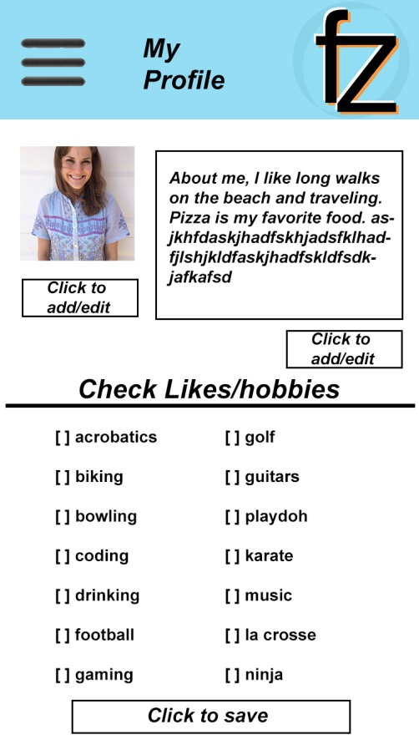
PROTOTYPE 2

Slide 7
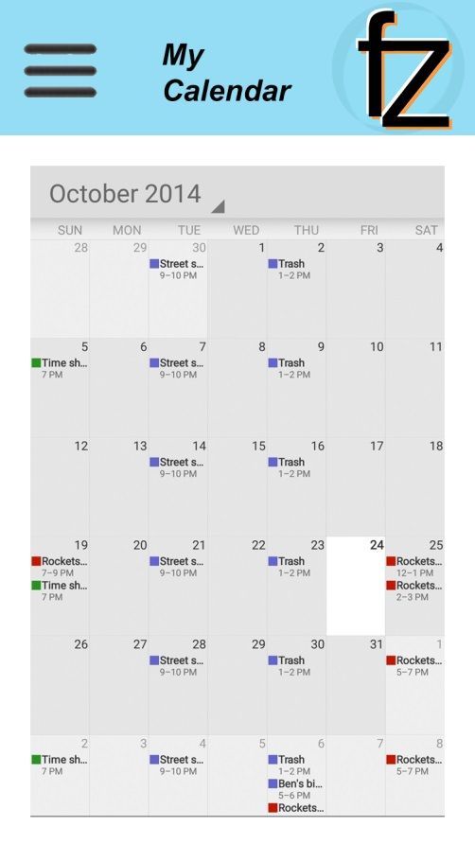
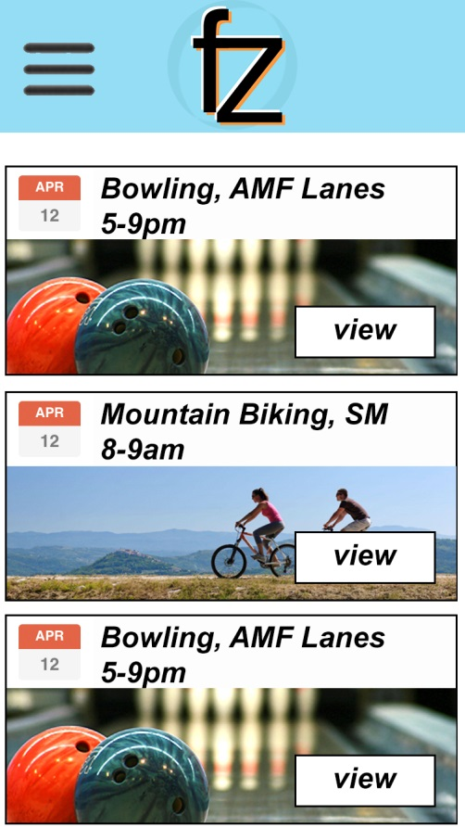
PROTOTYPE 2

Slide 8
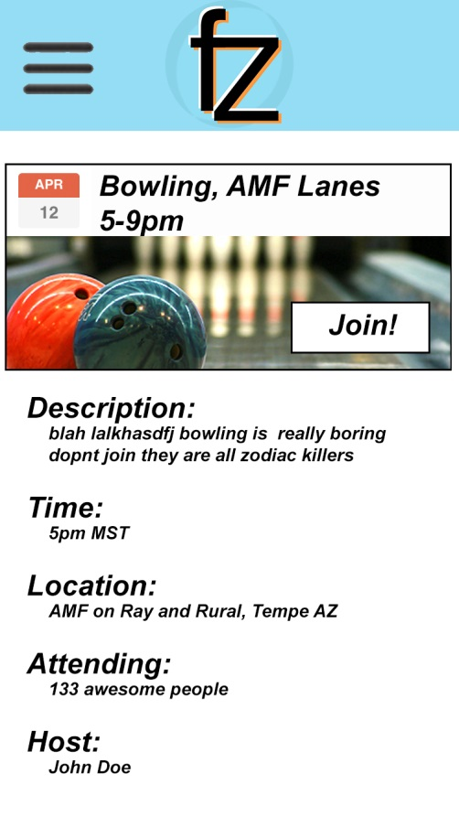
PROTOTYPE 2
Come join us for a great time at AMF lanes for games of bowling!

Slide 9
Metrics
We will use 2 metrics:
The % of surveyed users who sign up for our service.
The % of people who found an activity in our current list of activities that they would choose to join.
April 14, 2016, Measurement:
The % of survey users who signed up for our service increased by 13% from the previous measurement from 20% to 33%.
The % of people who found an activity increased by 33% from the previous measurement from 0% to 33%.

Slide 10
NEXT SPRINT REVIEW
Make physical prototype
Improve visual design
Survey random ASU students

